Slide 1
AGEING IN UGANDA: VALUES AND CHALLENGES
BY
JAMES NTOZI AND ABEL NZABONA
MAKERERE UNIVERSITY UGANDA

Slide 2
Introduction
Africa is often described as the continent with the youngest age structure.
However, even in this region, the age structure is changing dramatically.
In 1950 the number of people aged 60 and above numbered approximately 12 million in Africa (ECA, 2007).
By 2007, this number had increased fivefold to about 59.7 million people (UNFPA & HAI, 2012).
Although the percentage aged 60 and above is currently low in East African countries in comparison with developed countries such as Japan, long term projections indicate that the pace of ageing will be higher in the East African countries resulting in a substantial share of the aged population by 2100 (see Table 1).

Slide 3
Table 1 Projected Percentage of the Population aged 60+ in East African countries
compared with Japan, 2013, 2050 and 2100 (medium variant)
Country | 2013 | 2050 | 2100
Burundi | 3.9 | 6.9 | 17.2
Kenya | 4.3 | 9.5 | 21.9
Rwanda | 4.0 | 10.3 | 26.5
Uganda | 3.7 | 6.2 | 19.6
Tanzania | 4.9 | 7.3 | 18.2
Japan | 32.3 | 42.7 | 41.1
Source: UNDESA (2013)

Slide 4
Trends of Older Persons Population in Uganda
The population of older persons in Uganda has been increasing as displayed by the Figure 1, although the proportion is still low (3.7% in 2013) owing to high fertility rate.
For example, while the number recorded in the 1969 Census was 559,000, this figure increased to 686,300 as per the 1991 national census.
The 2002 national census indicated that older persons numbered 1,101,000, while the 2006 Uganda National Household Survey showed that this number had gone up to 1,196,400, doubling the 1969 population.
The recent national household survey of 2010 has shown that there were 1,304,500 older persons in the country (see Figure 1).
This older persons’ population is projected to reach 5,420,000 by 2050 (UNFPA & HAI, 2012).

Slide 5
Figure 1: Trend in population aged 60 and above in Uganda, 1969-2010
Source: MFEP (1995) & UBOS, (2005 & 2012)
Years

Slide 6
Uganda Study of Older Persons
Due to lack of data on older persons, a cross-sectional study was done in 2012;
Four rural districts were randomly selected while Kampala City was purposely chosen to represent urban centres,
A random sample of 605 older persons was interviewed, using a structured questionnaire to collect quantitative data on values and challenges of the aged, among other variables.
Owing to lack of time, this presentation will be limited on the descriptive analysis of the values and challenges of older persons, but more sophisticated analysis using advanced statistical methods has been done and is available in publications.

Slide 7
Values of Older Persons
Older persons as a population sub-group presents both a celebration and a challenge (UNFPA & HAI, 2012).
The celebration arises from older persons’ value, that is, their importance, worth or benefits and the challenge is exemplified by later life constraints that older persons face.
The values can be seen in various forms at individual, household and community levels.
Our Study showed that more than a quarter (27%) of older persons engaged in income-generating activities;
For example, Fig. 2 shows that majority of the respondents were small scale farmers followed by vendors of charcoal, water and other small items.

Slide 8
Figure 2: Percentages of older persons by types of economic activities engaged in

Slide 9
Values of Older Persons continued
Secondly, 26% of older persons were found to be leaders of social organisations they belonged to well into their advanced ages,
This is because older persons have more time to lead the organizations at times free of charge;
This makes older persons happy when they are valued by the community.

Slide 10
Values of Older Persons continued
Thirdly, it was found that almost half of the older persons (45%) possessed basic ethnoscience knowledge and skills.
The knowledge possessed included indigenous medicine, dispensing traditional medicine such as using plants to treat illness, soil conservation, basic and agrometeriology and applied climatology.
The indigenous skills reported were: craft product making (possessed by two thirds), house construction, brick making, pottery, etc
Fourthly, the study found that four out of five older persons propagated cultural norms and values as well as being custodians of vital information on historical events.
However, the older persons complained that their knowledge was gradually being missed because the present generation was more pre-occupied and obsessed with other ideas such as Information, Communication and Technology (ICT).

Slide 11
Values of Older Persons continued
Since rural out-migrants tend to be predominantly young adults, older persons tend to be non-movers and remain at their rural places of residence
The older persons tend to maintain family cohesion and secure family property.
For example, it is the older persons who monitor rural-based family property that would otherwise have fallen prey to vandalism, theft or grabbing.
Their urban-based off-springs tend to only make infrequent visits to rural areas probably at end of year or when a festive season is due.

Slide 12
Values of Older Persons continued
In Uganda many older persons are very supportive of their less successful and vulnerable family members.
Perhaps one of the most reported contributions of older persons in Uganda and Africa as a whole is playing the role of caregivers to HIV/AIDS orphans.
The older persons in Uganda have sacrificed their all to look after the orphans of their children and other relatives by providing education, shelter, health and psycho-social support.
The caregiving is not limited to the orphans, but other vulnerable children and even adults.
The study found that 50% of older persons, especially women take care of grandchildren whose parents have migrated for work purposes or social reasons.

Slide 13
Challenges of Older Persons
Decline in health is one of the several challenges that aging populations in Uganda face.
The study indicated that a third of the older persons had hearing difficulty and almost three quarters experienced sight and mobility problems in addition to a host of other health problems.
Income short fall is another challenge older persons have to contend with.
Owing to exclusion from the workforce upon reaching retirement age of 55, 60 or 65, older persons who were public servants rely on their pensions and social security where they exist.
However, in Uganda, only retirees of civil service are guaranteed monthly pensions.
Some monthly pensions from Government bodies are too small and do not cater for inflation, which makes retirees face hard lives (MoGLSD, 2009).

Slide 14
Challenges of Older Persons Continued
Unlike Government bodies, many other employers prefer using gratuity and social security systems, such as contributing to Provident Fund organizations, which will pay retirement benefits once at the end of their employees services.
This would mean that if the terminal benefits are not well invested, the retirees will be on their own later and suffer.
Due to small public and private sectors, the majority of older persons in Uganda have no pensions or social Security systems to fall back to;
The study showed that close to 6 out of 10 older persons were not receiving pension of any kind.

Slide 15
Challenges of Older Persons Continued
In the past, this group was catered for by the extended family system. Children, especially the sons were traditionally obliged to look after their parents until the parents died.
But due to the impact of HIV/AIDS and frequent wars on families, adult children of many older persons died and left their aging parents without help.
Secondly, many young persons have migrated to urban centres and left the older persons behind lonely and without much assistance.
The study found that 7 out of 10 Older persons were lonely.
While 74% of older women were affected by loneliness, lower proportion of 59% of men were affected. This is partly because the widowers find it easier to remarry and get company than the widows. Secondly, women survive their spouses more than men do.

Slide 16
Challenges of Older Persons Continued
Other challenges mentioned included:
Nutrition inadequacies – 64% of older persons were not eating all three daily meals required, which was likely to lead to malnutrition.
Poor quality housing – 64% of respondents lived in houses with structural problems, mostly grass thatched and leaking and in dilapidated state (see Figure 3); This challenge is more serious in rural areas (68%) than urban centers (49%).

Slide 17
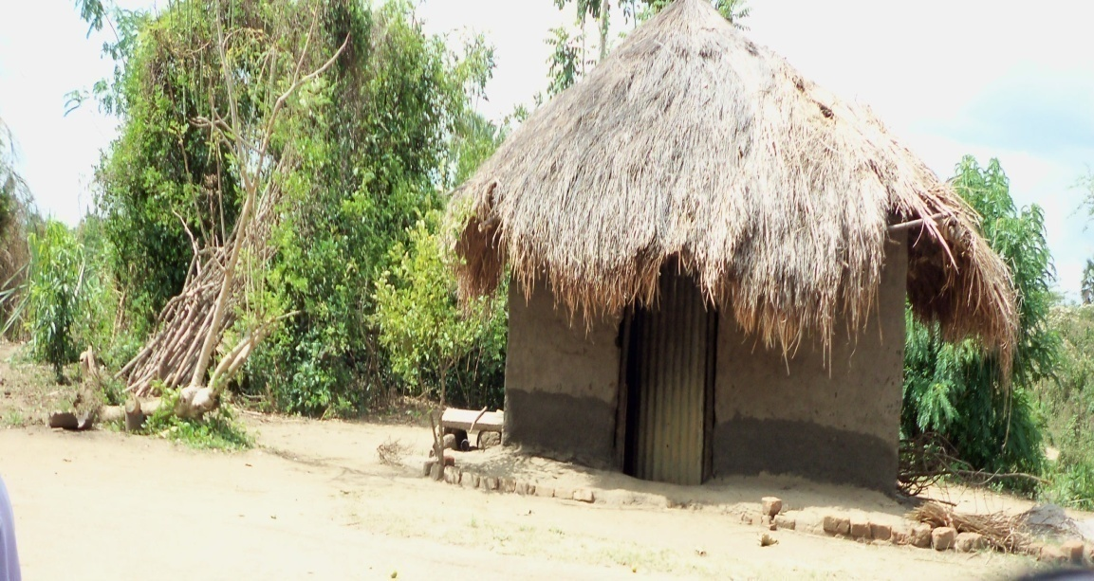
Figure 3: An older woman’s dilapidated grass thatch shelter

Slide 18
Way Forward
Government should establish a Special Old Age Fund.
This fund can be realised through levying a tax on an item such as airtime across all telecommunication networks and each public employee’s income.
Government should set up geriatric wings in public hospitals that would manage old age-related health issues such as hearing and sight loss.
Government should decentralise old-age healthcare system in which older persons are managed at or near their homes. This would greatly reduce mobility difficulties of older persons.
Future studies should target specific aspects of values and challenges of older persons.

Slide 19
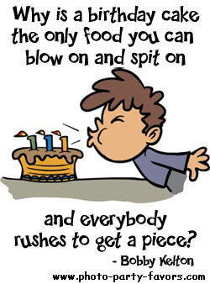
MERCI BEAUCOUP – ASANTE SANA

