Slide 1
Ageing and the Changing Nature of Intergenerational Flows in Thailand
Suphannada LOWHACHAI
Office of the National Economic and Social Development Board, Thailand
September 30, 2015

Slide 2

1
Demographic and Welfare Situation in Thailand
2
Economic Life Cycle of the Thai Population
3
Effects of Demographic Change on Economic Life Cycle

Slide 3
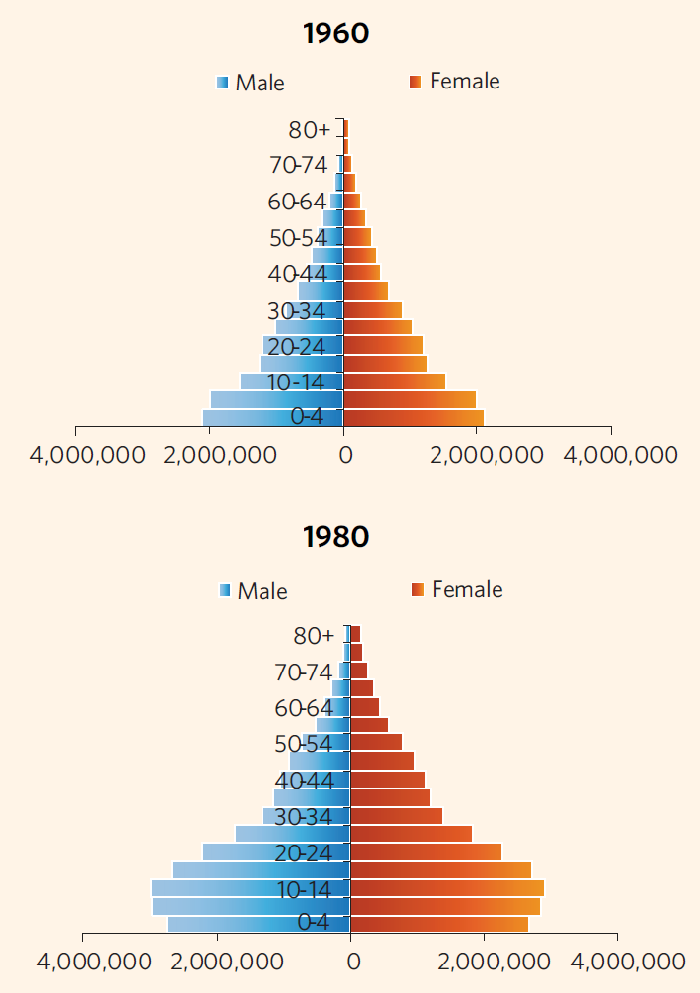
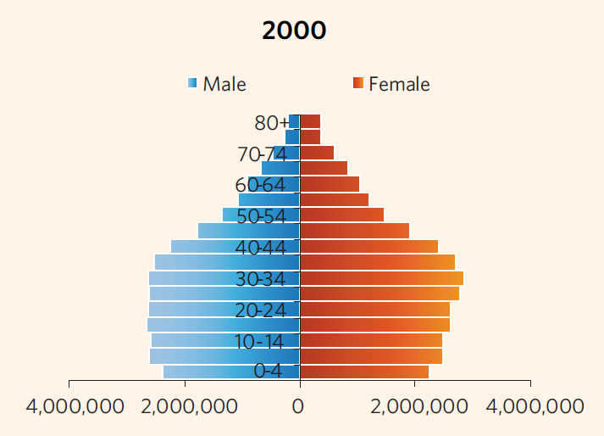


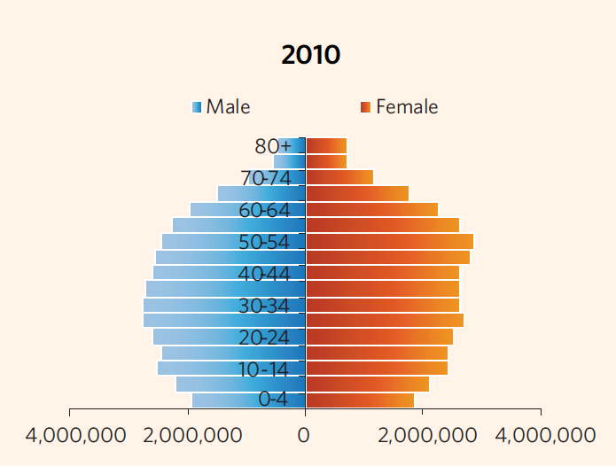
Demographic Situation in Thailand – the Recent Past
Real GDP
160,955
Baht
GDP per capita
1,438 Baht
Sharp changes in age structure with large working-age population from mid-1980s has caused the Thai economy to grow rapidly.
Notes:
Fertility decline since the 1960s has led to dramatic changes in growth of different age segments of the population, and correspondingly, to sharp changes in age structure. These are very obvious in the age pyramids shown in the figure. Between 1960 and 2000, Thailand’s age pyramid changed from a broad-based, high fertility age structure to one in which each of the 5-year cohorts aged 15–39 was larger than the 5-year cohorts in the childhood ages
At the same time,

Slide 4

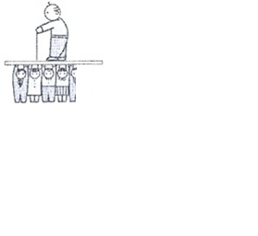
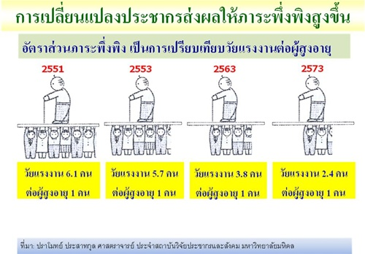
Demographic Situation in Thailand – the Near Future
2015
2040
SPEED of AGEING
Fertility Rate
1.62
1.3
Thailand is ageing much faster than developed countries
Age Structure
Support Ratio
4.2 : 1
1.7 : 1
Notes:
Thailand has experienced a rapid demographic transition → ageing rapidly while children and working-age population decreasing
อัตราเจริญพันธุ์รวมของประเทศลดลงอย่างต่อเนื่องจาก 5.1 คน ในปี 2515 เหลือ 1.6 คน ในปี 2553 ซึ่งต่ำกว่าระดับทดแทน ทำให้การคาดประมาณประชากรของประเทศไทย พ.ศ. 2553-2583 พบว่า
ประชากรไทยจะเพิ่มขึ้นสูงสุดเป็น 66.4 ล้านคน ในปี 2569 จากนั้นจะค่อยๆ ลดลงเหลือ 63.9 ล้านคน ในปี 2583
สัดส่วนประชากรวัยเด็กและวัยแรงงานจะลดลง ขณะที่ประชากรวัยสูงอายุมีแนวโน้มเพิ่มขึ้น
นำไปสู่การขาดแคลนแรงงานอย่างรุนแรง และภาวะพึ่งพิงเพิ่มมากขึ้น
Population ageing in Thailand is occurring faster than it did in the past in more developed countries in the West

Slide 5
Welfare Situation in Thailand
Age (yrs.) | Workers in formal sector (37.4% ) |  | Workers in informal sector (62.6%)
0-3 | Cash transfer: 400 baht/person/month |  | -
4-6 | 400 baht Cash Transfer | Free education for 15 years
7-18 | Free education for 15 years
19–59 | Social security scheme |  | Voluntary social security scheme (Article 40)
60+ | Pension fund |  | Elderly allowance: 600 to 1,000 baht/person/month
Disability | 50% compensation of regular income Disability fund: 500 baht/month |  | Disability fund: 500 baht/month transfer
HIV/AIDS | Social Cash Transfer: 500 baht/month
All age groups | Universal Health Care/Civil Servant Medical Benefit/Social Security/Compulsory Migrant Health Insurance

Slide 6
1
Demographic Situation in Thailand
2
Economic Life Cycle of the Thai Population
3
Effects of Demographic Change on Economic Life Cycle

Slide 7
Method: National Transfer Accounts (NTA)
What is National Transfer Accounts?
National Transfer Accounts or NTA are data that incorporate ages into GDP.
Describes the age patterns of economic activity and the economic relations between the generations.
Quantifies how each age groups acquires and uses economic resources.
The goal is to improve our understanding of the “generational economy”
Constructed using existing data (population estimates, surveys, administrative records, macroeconomic data).
Consistent with UN System of National Accounts.

Slide 8
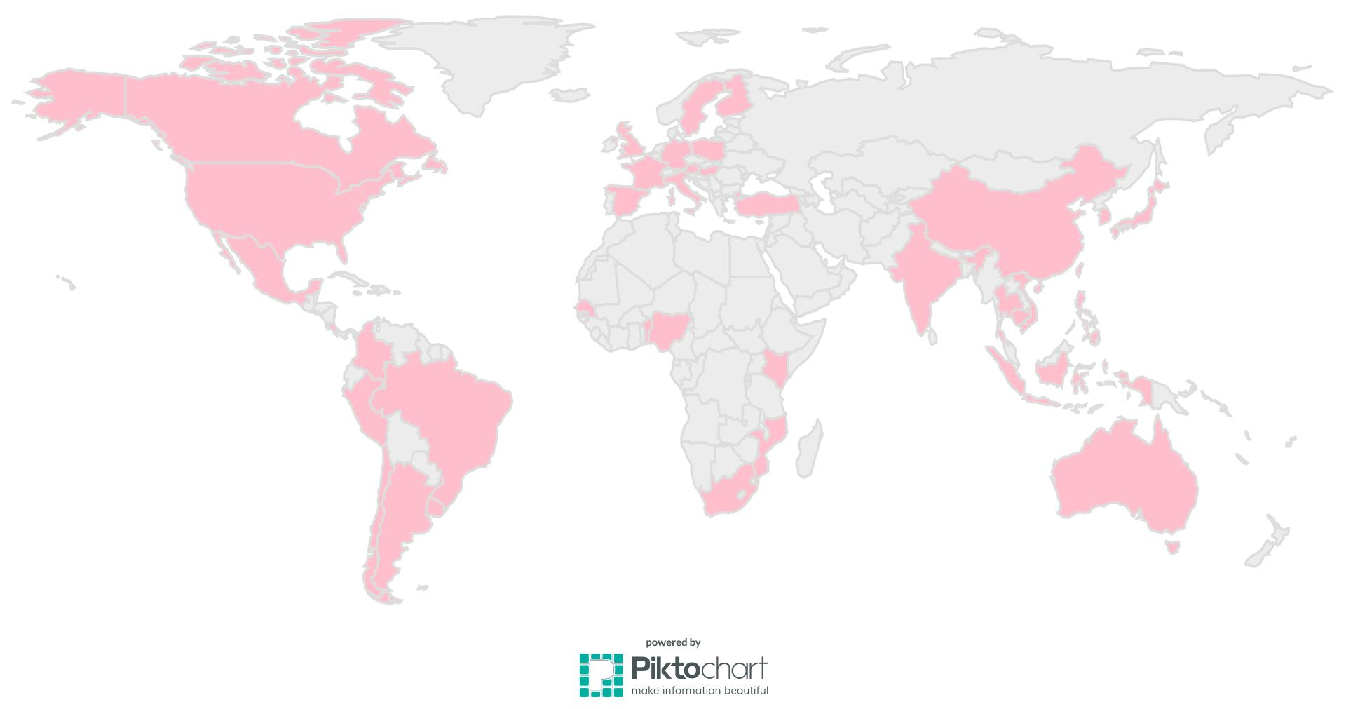
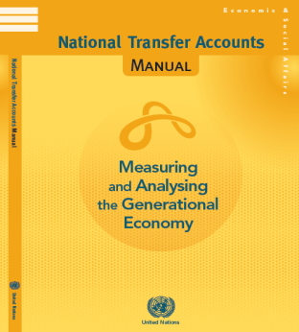
NTA is comparable internationally
As of June 2013, there are 41 member countries and still expanding
Consistence compilation method across countries (NTA Manual published by UN is available online)
Notes:
แนวคิด NTA เกิดขึ้นจากแนวคิดทางเศรษฐศาสตร์ที่สนใจมิติด้านโครงสร้างประชากร และบทบาทของการโอนระหว่างรุ่นอายุ (Intergenerational Transfers) ในระบบเศรษฐกิจ
โครงการ NTA ระดับนานาชาติเริ่มขึ้นครั้งแรกในปี 2545 ประกอบด้วย 7 ประเทศ ได้แก่ สหรัฐอเมริกา ใต้หวัน ญี่ปุ่น อินโดนีเซีย บราซิล ชิลี และฝรั่งเศส
ปัจจุบัน (ณ เดือนมิถุนายน 2556) มีสมาชิกรวม 41 ประเทศ

Slide 9
Life Cycle Deficit
Consumption and Labour Income, per capita value (Thai Baht), year 2011
Thai population has an income surplus during the ages of 25-59.
The rest age groups (0-24 and 60+), on the other hand, have consumption expenditure higher than their labor income and incur a deficit.
surplus
deficit
deficit

Slide 10
Labour Income
Annual Per-capita Labour Income (Thai Baht), year 2011
Labor income is highest at age 53, with average income of THB 164,278 per person per year.
Then, the labor income gradually decline until reaching zero at the age of 92
Compensation of employees accounts for larger share of labor income when population is in early working ages.
However, self-employed labor income has increasingly become the main source of labor income when population gets older.

Slide 11
Consumption
Consumption by type, per capita value (Thai Baht), year 2011
Most of the consumption expenses are paid by private sectors
Public sectors subsidizes education for children and health services for elderly.
Similarly, out of pocket education expense is made during childhood and out of pocket health care expense increases after retirement.
Notes:
Explain how current social welfare system is reflected in the graph

Slide 12
Consumption of Other Countries
SOUTH KOREA
SWEDEN

Slide 13
Results: Aggregate Consumption and Labour Income
Per capita values
Population structure
Aggregate Consumption and Labor Income (Mil.Baht)
Year 2011
surplus
deficit
deficit
Notes:
The aggregate deficit—occurred for age 0-24 and 60 years and over—is larger than the aggregate surplus.
This life-cycle deficit for has to be covered by 2 channels of reallocations—asset-based reallocation and transfers.

Slide 14
Sources for Consumption
Percentage shares of each income sources to finance consumption, year 2011
Children’s consumption (0-4) is mostly financed by private transfers.
Income sources used to finance teenager’s consumption (15-24) are mixed. Yet, private transfer remains a dominant income source.
Unsurprisingly, working-age’s consumption (25-59) is mainly financed by labor income. The surplus is reallocated to the other age groups.
For the elderly group, 60% of consumption expense is mainly financed by asset based reallocation, and around 10% by labor income.
It should be noted that elderly group also generates surplus to support other age groups. This is because the pension received was higher than their consumption.

Slide 15
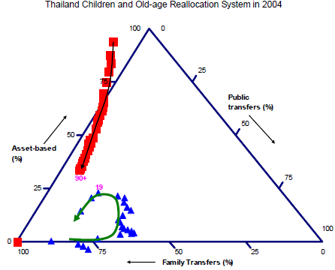
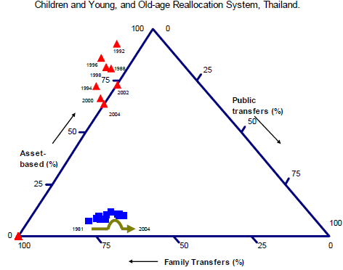
Sources of Income for Elderly between 1992-2004
Capital-based transformation
Traditional System
Social welfare transformation
Source: Mathana (2004)
As Thai elderly gets older, they relies more on family support.
Over time, Thai elder has also become more reliable on family support.

Slide 16
1
Demographic Situation in Thailand
2
Economic Life Cycle of the Thai Population
3
Effects of Demographic Change on Economic Life Cycle

Slide 17
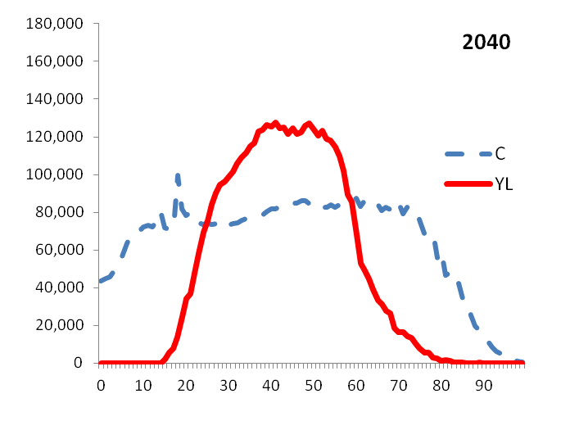
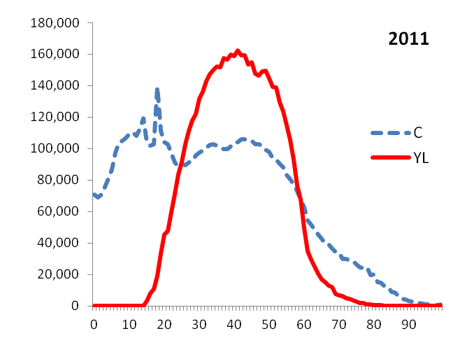
Effects of Demographic Change on Economic Life Cycle
Aggregate Labour Income & Consumption (Mil. Baht)
  These simulation results have been incorporated in the drafting of Population Plan during the Twelfth National Economic and Social Development Plan (2017-2021)
Here, we assume that per capita income and consumption for all ages remain the same in 2040 as in 2011.
In 2040, aggregate consumption of the population in older ages considerably increases while consumption of children and working ages decline compared to 2011. Aggregate labor income will also be lower.
Overall life-cycle deficit to increase from 1.3 trillion Baht in 2011 to a deficit of 1.8 trillion Baht in 2040.

Slide 18
Policy Implications: How can we prepare for such effects?
Increase the surplus of working age group to support the higher deficit from an increasing size of dependent elderly.
  Increase labour productivity.
  Increase labour participation by encouraging
  elderly to work longer and promoting youth
  employment.
Promote healthy behaviours to lessen health care cost especially from dependent elderly.
Ensure income security after retirement.

Slide 19
Increase Surplus of Working Ages
Aggregate Labour Income & Consumption (Mil. Baht), year 2040
Both extending retirement age and increasing productivity will likely help raise aggregate labour income of the Thailand.
YL0 = base case
YL1 = raise retirement age
YL2 = productivity increases 3% per annum
YL3 = raise retirement age with 3% per annum productivity increase

Slide 20
Ensure Income Security after Retirement
Old-age Support System
On average, Thai elderly has been the net transfer givers rather than net receivers.
Thai elderly relies more on income from assets, particularly when compared to other countries.
Capital-based transformation
Traditional System
Social welfare transformation

Slide 21
More on Policy Implications
Public expenditure for children were mainly on compulsory level
Start investing on early childhood
After age 24, education consumption dropped considerably
Promote life-long learning
Public expenditure was lowest for working ages
Invest more on productivity enhancement
Elderly financed most of their consumption from their asset income
Consider establishing old-age security system

Slide 22

Thank you
www.nesdb.go.th

Slide 23



NTA Data & Method
Aggregate Control
NI 2011 (NESDB)
Age Profiles
SES 2011 (NSO)
Health and Welfare Survey 2011 (NSO)
Population
Population Projections 2010-2040 (NESDB)
Education Statistics 2011 (MOE)
Method
☞ Simply follows the NTA Manual (2013)

Slide 24
Health and Education Consumption, 2011
Annual Per-capita Education Expenditure (THB)
Annual Per-capita Health Expenditure (THB)
Private Consumption, Health
Average education consumption is high in the compulsory education ages while health consumption increases with ages.
Education in Thailand is mainly financed by public sector, particularly the compulsory education. For health expenditure, private sector plays more role.
Notes:
Education in Thailand was mainly financed by public resources.
The public share was higher than 80% for almost all education levels except for the elderly group (60+)
It should be noted that public spending on education was highest in primary education level (5-14).
This is due to the fact that in Thailand, this education level is compulsory and fully supported by the government.
public-private share of health expenditure was varied with age.
The percentage share of public spending on healthcare was higher in early childhood (0-5) and elderly (60+) groups, almost equal private contribution in children (5-14) and working age (25-59) groups, and less than private spending in teenager group (15-24).
It should be noted that in 2011, the health consumption of population age 60 years and above was highest compare to other age groups

