Slide 1

Medical Abortion in Our Hands using international online abortion service as a strategy for empowerment and activism in Poland.
Kinga Jelinska kinga@womenhelp.org
Paris 2015

Slide 2
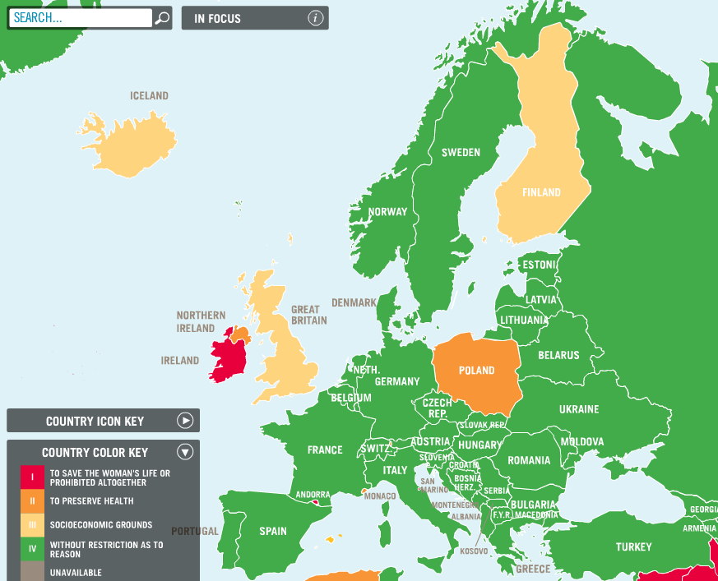

Slide 3
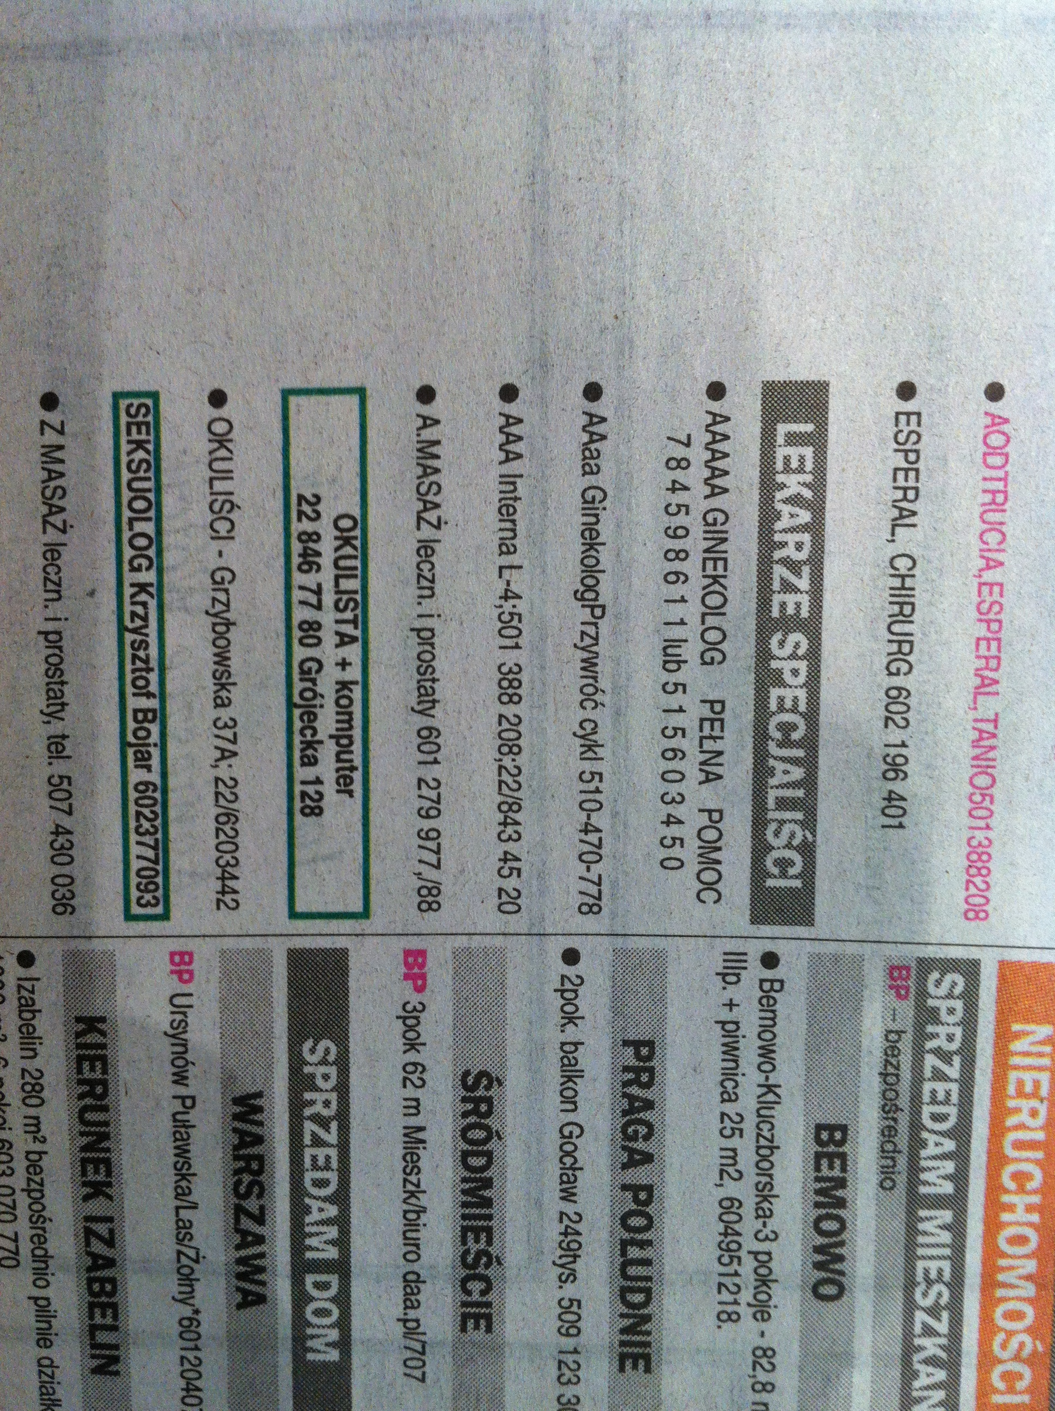
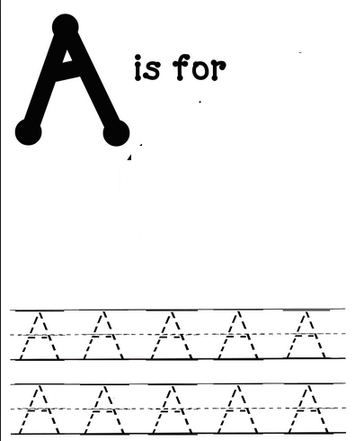

abortion

Slide 4
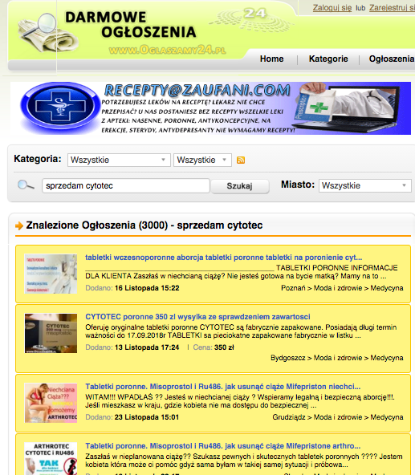
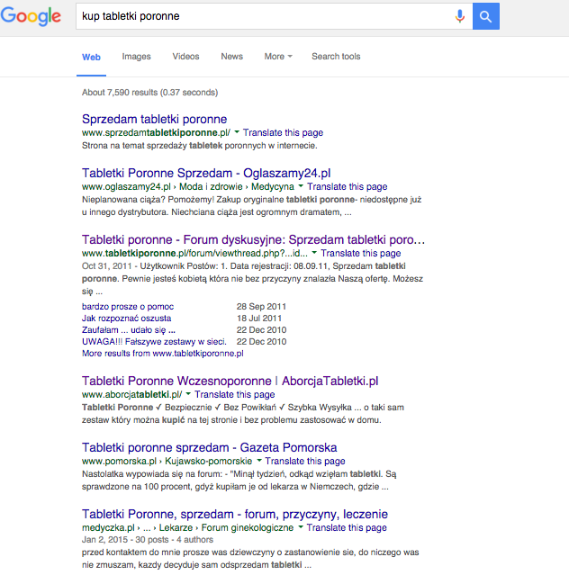
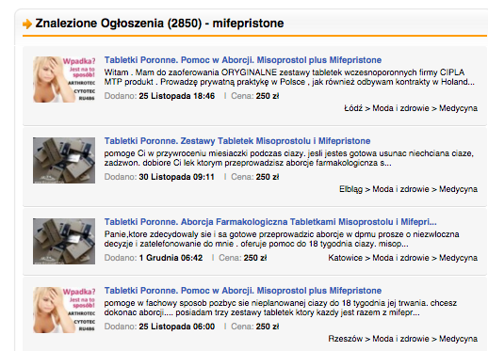

Slide 5
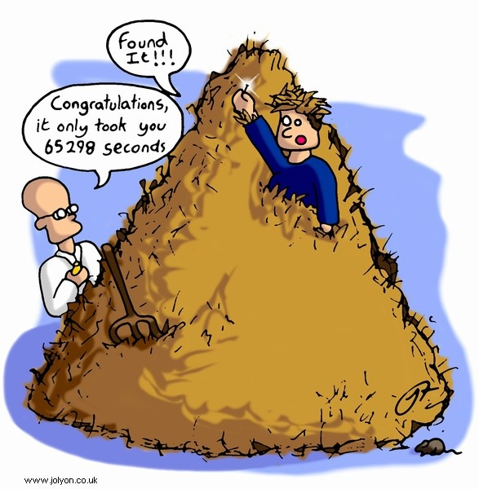


Slide 6
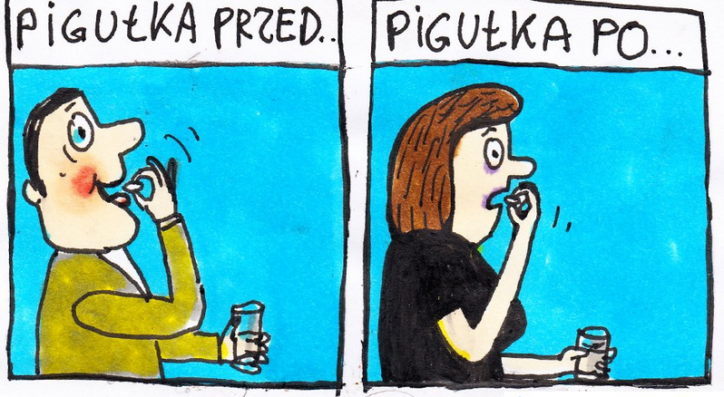
Pill before
Pill after

Slide 7
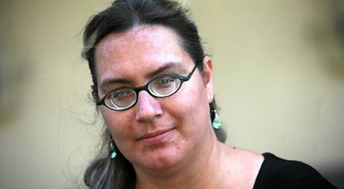

Slide 8
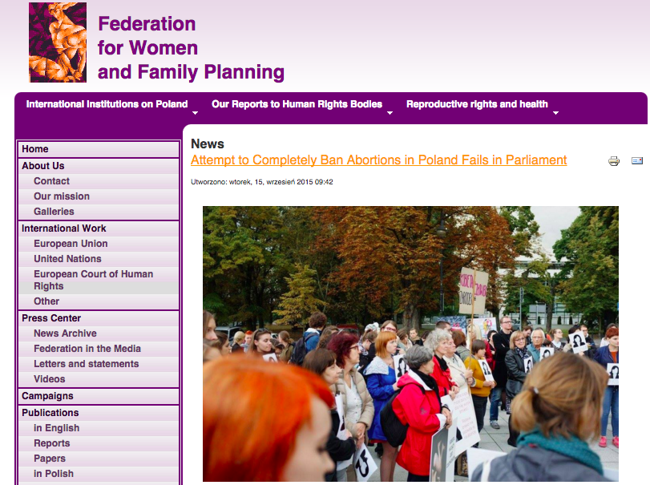

Slide 9


Slide 10


Slide 11

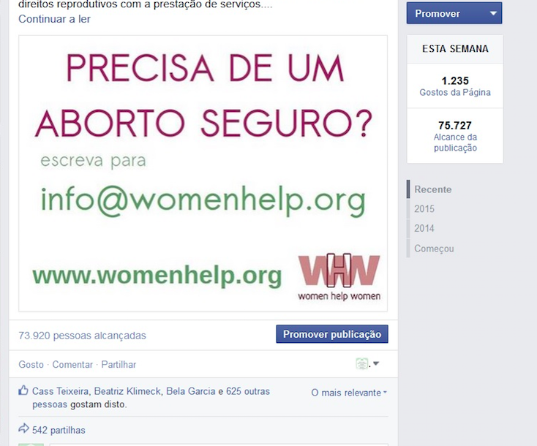



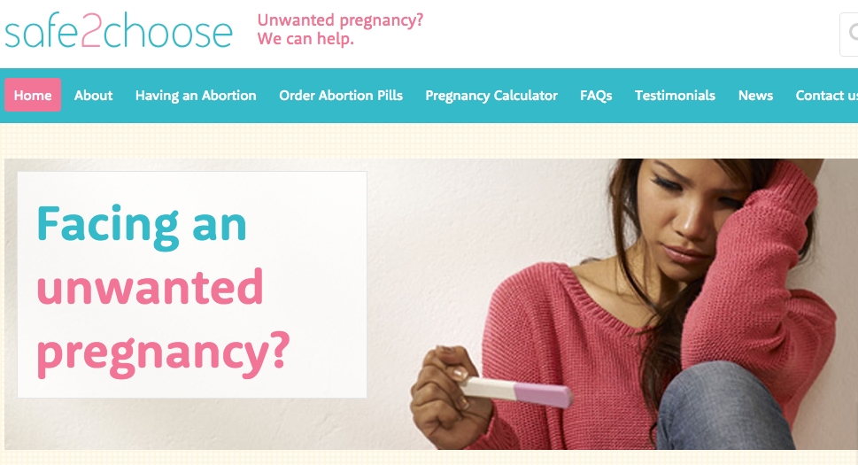
WHERE
to get pills?

Slide 12
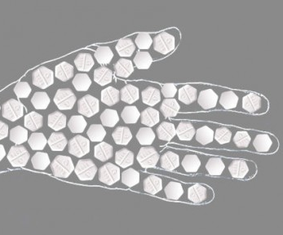


WHERE
to get pills?
WHO
has the
control?

Slide 13



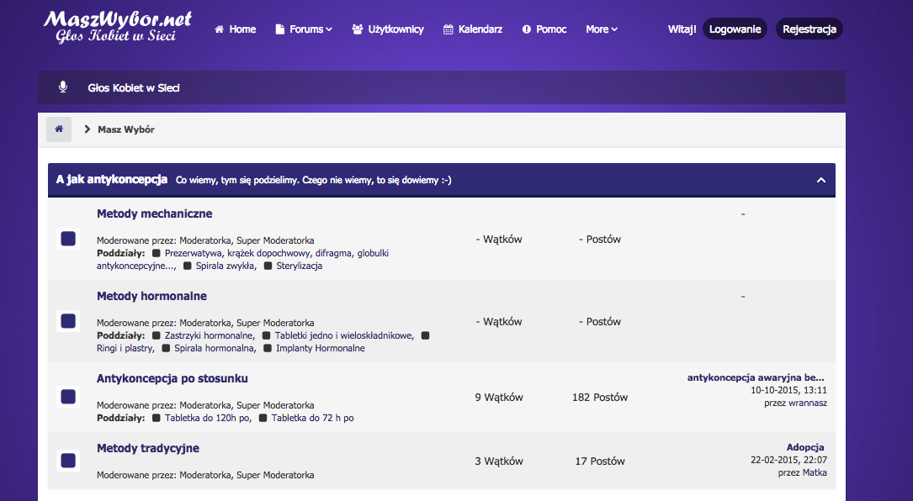

WHERE
to get pills?
WHEN
will it change?
WHO
has the
control?

Slide 14



