Slide 1
Forgotten Marriages? Measuring the reliability of Retrospective marriage histories
Sophia Chae
Population Studies Center
University of Pennsylvania
March 20, 2012
INED – Quality and Comparability of Demographic Data in Sub-Saharan Africa

Slide 2
Introduction
Retrospective marriage histories are often the best way to collect information on past marriages
Limitations
Recall error
Definition of marriage?
Unclear to what extent results are affected by these limitations
Validity vs. reliability

Slide 3
Research Questions
What are the characteristics of marriages that are misreported?
What are the characteristics of respondents who misreport marriages?
How are marriage analyses affected by misreporting of marriages?

Slide 4
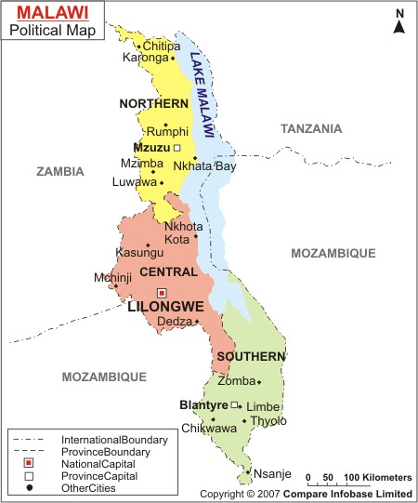
Marriage in Malawi
Marriage is universal
High rates of divorce
Patrilineal & matrilineal kinship systems
Polygamy is common
Regional differences
North
Central
South

Slide 5
Data
Malawi Longitudinal Study of Families and Health (MLSFH)
Formerly known as the Malawi Diffusion and Ideational Change Project (MDICP)
Three rural sites
Rumphi (North), Mchinji (Central), Balaka (South)
2006 (MLSFH4) and 2010 (MLSFH6)
Detailed marriage histories and interviewer data
Analytic sample (1,148 women & 719 men)
Ever been married by 2006
Interviewed by main survey team in 2006 & 2010
Reports of number of times married = number of spouses reported in marriage history

Slide 6
Methods (1)
Part I: Match marriages across surveys using spouse names and dates of marriage
Matching process, by gender, 2006 and 2010
 | Men | Women
Number of marriages reported in 2006 | 1225 | 1593
Number of marriages reported in 2010 | 1109 | 1480
Difference (2006-2010) | 116 | 113
Match rates
% marriages reported in 2006 also reported in 2010 | 84.7 | 89.5
% marriages reported in 2010 also reported in 2006 | 93.6 | 96.3

Slide 7
Methods (2)
Part II: Reconstruct marriage histories (RMH)
Marriage order
Year marriage began
Status of marriage
Still married
Separated/divorced
Widowed
Year marriage ended

Slide 8
RMH Match Statistics
 | Men | Women
Marriage-level
Unmatched marriages (%) | 18.8 | 12.9
Number of marriages | 1369 | 1728
Individual-level
Did not report at least one marriage (%)
All respondents | 26.2 | 16.3
Married more than onceª | 51.8 | 46.0
Did not report multiple marriages^{b} (%) | 22.5 | 15.6
Number of respondents | 729 | 1138
ª Refers to respondents married more than once by 2006 survey
^{b} Among those who did not report at least one marriage

Slide 9
Statistical Analyses
Outcome 1: unmatched marriage
Restricted to marriages that took place before 2006
Regression: multinomial logistic regression
Base outcome = matched terminated marriage
Other outcomes = unmatched terminated marriage, current marriage
Outcome 2: reported consistent marriage start date
Restricted to matched marriages
Regression: logistic regression
Outcome 3: reported consistent marriage end date
Restricted to matched terminated marriages
Regression: logistic regression

Slide 10
Independent Variables
Individual
Age, age squared, region of residence, education, inconsistent reporting of survey responses (level of education, number of children ever born, number of lifetime sexual partners)
Marriage
Marriage order, years since marriage began, short duration marriage, status of marriage
Survey
Interviewer knows respondent’s family (2006), degree of cooperation, length of survey time (2010)
Interviewer (2010)
Age, age squared, male, ever married, has prior interviewing experience, lives outside district of respondent
Problem: 2006 interviewer data is missing for 28% of sample

Slide 11
Marriage Statistics: 2006/2010 vs. RMH
Marriage Statistics
Age at first marriage
Number of times married
Ever divorced
Number of times divorced
Ever widowed
Paired t-test or Wilcoxon signed rank sum test

Slide 12
Reported Number of Times Married in 2006 & 2010, Men
 |  | 2010
 |  | 1 | 2 | 3 | 4 | 5 | 6 | 7 | Total
2006 | 1 | 337 | 51 | 6 | 0 | 0 | 0 | 0 | 394
 | 2 | 58 | 137 | 19 | 4 | 2 | 0 | 0 | 220
 | 3 | 13 | 23 | 36 | 9 | 1 | 1 | 1 | 84
 | 4 | 8 | 4 | 3 | 5 | 1 | 1 | 0 | 22
 | 5 | 1 | 0 | 3 | 1 | 2 | 0 | 0 | 7
 | 6 | 0 | 0 | 0 | 0 | 0 | 1 | 0 | 1
 | 7 | 0 | 0 | 0 | 0 | 0 | 0 | 0 | 0
 | 8 | 0 | 0 | 0 | 0 | 0 | 0 | 0 | 0
 | 9 | 0 | 1 | 0 | 0 | 0 | 0 | 0 | 1
 | Total | 417 | 216 | 67 | 19 | 6 | 3 | 1 | 729

Slide 13
Reported Number of Times Married in 2006 & 2010, Women
 |  | 2010
 |  | 1 | 2 | 3 | 4 | 5 | 6 | 7 | Total
2006 | 1 | 733 | 49 | 3 | 0 | 0 | 0 | 0 | 785
 | 2 | 70 | 165 | 32 | 2 | 1 | 0 | 0 | 270
 | 3 | 12 | 21 | 31 | 5 | 0 | 0 | 0 | 69
 | 4 | 1 | 2 | 4 | 3 | 0 | 0 | 0 | 10
 | 5 | 2 | 0 | 0 | 0 | 0 | 0 | 1 | 3
 | 6 | 0 | 0 | 0 | 1 | 0 | 0 | 0 | 1
 | Total | 818 | 237 | 70 | 11 | 1 | 0 | 1 | 1138

Slide 14
Odds Ratios of Unmatched vs. Matched Marriage
Statistically Significant Variables | Men | Women
Individual Characteristics
Age | 1.00 | 1.20***
Age squared | 1.00 | 1.00***
Inconsistent reporting of:
# lifetime sexual partners | 1.26 | 3.64***
Marriage Characteristics
Short duration marriage | 3.51*** | 4.61***
Interviewer Characteristics (2010)
Has prior interviewing experience | 0.53* | 1.62+
*** p<0.001, ** p<0.01, * p<0.05, + p<0.10

Slide 15
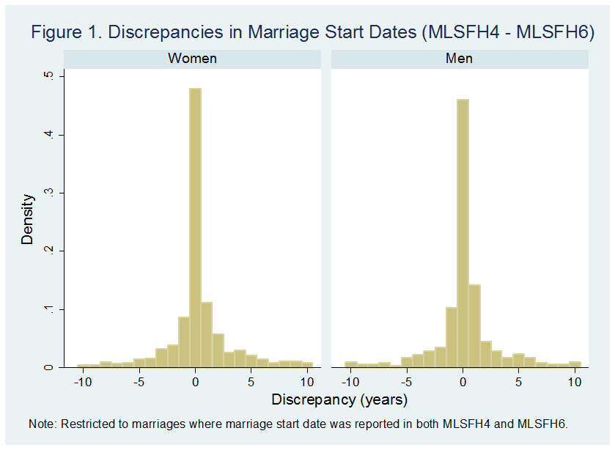
Discrepancies in Marriage Start Dates

Slide 16
Discrepancies in Marriage End Dates

Slide 17
Odds Ratios of Reporting Consistent Marriage Start Date (1)
Statistically Significant Variables | Men | Women
Individual Characteristics
Region of residence (ref = Central)
South | 0.42*** | 0.40***
North | 0.82 | 0.88
Completed 5+ grades of schooling | 1.50* | 2.03***
Inconsistent reporting of:
# children ever born | 1.05 | 0.50**
# lifetime sexual partners | 1.06 | 0.69*
Marriage Characteristics
Marriage order (ref = First)
Second | 0.53** | 0.68+
Third or higher | 0.61+ | 0.97
Short duration marriage | 0.85 | 0.63*
*** p<0.001, ** p<0.01, * p<0.05, + p<0.10

Slide 18
Odds Ratios of Reporting Consistent Marriage Start Date (2)
Statistically Significant Variables | Men | Women
Marriage Characteristics (cont’d)
Status of marriage (ref = still married)
Divorced | 0.81 | 0.75
Widowed | 0.35* | 0.58*
Survey Characteristics
Degree of cooperation in 2010 (ref = good)
Very good | 1.01 | 1.10
Average/bad | 1.01 | 0.68*
Length of survey time in 2010 (ref = middle)
Short | 0.64* | 1.12
Long | 0.95 | 1.00
Interviewer Characteristics (2010)
Has prior interviewing experience | 1.68* | 0.86
* p<0.05

Slide 19
Odds Ratios of Reporting Consistent Marriage End Date
Statistically Significant Variables | OR
Age | 0.89*
Completed 5+ grades of schooling | 2.25**
Short duration marriage | 0.45**
Significant Gender Interactions | OR
Male | 2.21*
Ended in Widowhood | 2.14*
Male X Ended in Widowhood | 0.19**
Interviewer lives outside district of respondent (2010) | 2.25*
Male X Interviewer lives outside district of respondent (2010) | 0.10**

Slide 20
Marriage-related Statistics (means)
Men | Variables | 2006 | RMH |  | 2010 | RMH
 | Age at first marriage | 22.2 | 22.0 | *** | 22.4 | 22.0 | ***
 | # times married | 1.68 | 1.78 | *** | 1.62 | 1.88 | ***
 | # times divorced | 0.47 | 0.53 | *** | 0.43 | 0.64 | ***
 | Ever divorced (%) | 34.6 | 37.4 | *** | 30.0 | 41.8 | ***
 | Ever widowed (%) | 7.6 | 8.7 | ** | 7.8 | 9.7 | **
Women | Variables | 2006 | RMH |  | 2010 | RMH
 | Age at first marriage | 17.8 | 17.7 | *** | 17.8 | 17.7
 | # times married | 1.40 | 1.45 | *** | 1.37 | 1.52 | ***
 | # times divorced | 0.42 | 0.45 | *** | 0.39 | 0.54 | ***
 | Ever divorced (%) | 34.0 | 35.2 | * | 29.0 | 37.3 | ***
 | Ever widowed (%) | 10.0 | 10.6 | * | 12.7 | 12.4

Slide 21
% Respondents Who Report Inconsistent Number of Times Married Across Survey Waves
Men |  |  | Later Survey
 |  |  | 2004 | 2006 | 2008 | 2010 | Total
 | Earlier Survey | 2001 | 7.3 | 7.3 | 14.6 | 15.2 | 328
 |  | 2004 | - | 11.6 | 15.9 | 17.5 | 447
 |  | 2006 | - | - | 14.1 | 15.1 | 608
 |  | 2008 | - | - | - | 10.5 | 608
Women |  |  | Later Survey
 |  |  | 2004 | 2006 | 2008 | 2010 | Total
 | Earlier Survey | 2001 | 9.9 | 10.2 | 15.3 | 15.4 | 629
 |  | 2004 | - | 7.3 | 11.1 | 11.6 | 765
 |  | 2006 | - | - | 10.6 | 10.1 | 976
 |  | 2008 | - | - | - | 9.2 | 976

Slide 22
Main Findings
Significant amount of underreporting of marriages exists in MLSFH
Men are more likely to misreport marriages than women
Underreporting of marriages and inconsistent reporting of marriage dates do not appear to be random
Marriage-related statistics are affected by underreporting of marriages
Underreporting is a more serious problem in 2010
Possible explanation → panel conditioning
Limitation
Some respondents may consistently underreport the same marriages
True number of marriages is likely higher

Slide 23
Discussion & Implications
Are retrospective marriage histories reliable?
26.2% of men and 16.3% of women omitted at least one marriage
Better recall of marriage start dates than end dates
How does misreporting of marriages affect research?
Depends largely on the research question and type of misreporting
What does this mean for large-scale surveys collecting marriage data?
Retrospective marriage histories are probably not capturing all marriages
Levels of misreporting will depend on local marriage patterns

Slide 24
Thank you!
Comments or questions?
sochae@sas.upenn.edu

